Slide 1

NEUROETHICS FOUNDATION
CREATING
POST-DARWINIAN LIFE
Could two small genetic tweaks get rid of most of the world’s physical and mental pain?
DAVID PEARCE

Slide 2
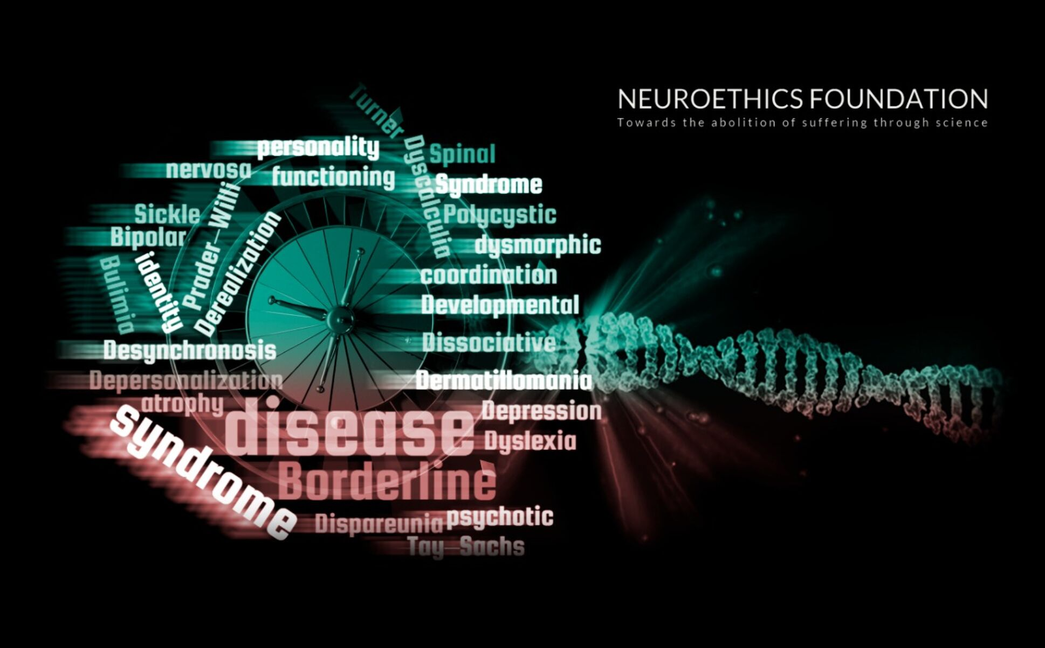

Slide 3

Human Genetic Experimentation
Is it ethical to create children who will suffer a terrible genetic disease (aging), multiple intellectual handicaps, and terrible mental and physical pain?

Slide 4

Yes.
Life is wonderful!

Slide 5
TIME FOR A MORATORIUM ON RECKLESS GENETIC EXPERIMENTS?
Antinatalism won’t solve the problem of suffering. Staying child-free - or adopting - imposes selection pressure in favour of baby-making.

Slide 6
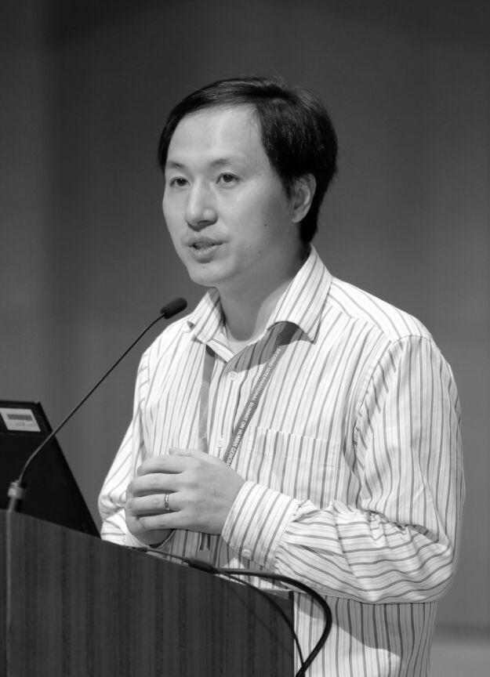
He Jiankui
Used CRISPR
gene-editing technology to tweak the DNA of human embryos during in vitro fertilization.
"This experiment is monstrous.”
(Julian Savulescu, Medical Ethicist, University of Oxford)

Slide 7
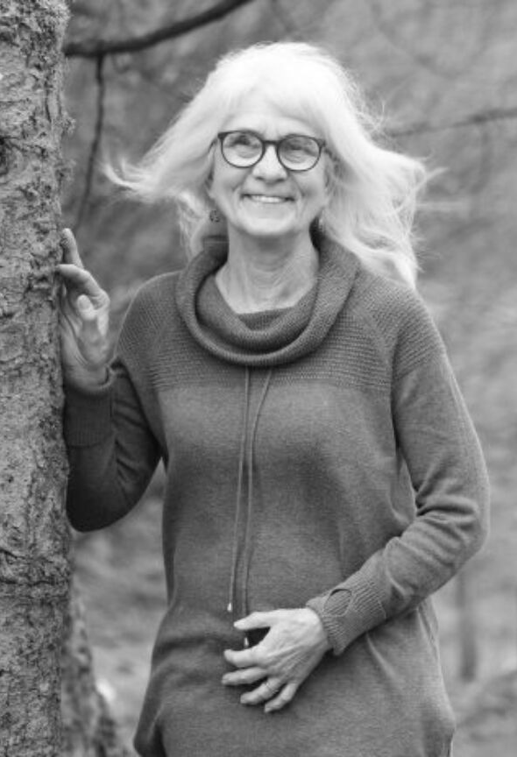
FAAH and the newly-discovered FAAH-out gene
Jo Cameron
  72 year old vegan
  Retired school teacher
  Experiences almost no physical or mental pain
  Childbirth "felt like a tickle"
  Chronic mild euphoria
  Information-sensitive gradients of well-being

Slide 8
  Absence or underactivity of the FAAH gene is associated with reduced pain-sensation.
  Accelerated wound-healing
  Rapid extinction of fearful memories
  Reduced anxiety
  High hedonic set-point
  Lifelong happy mood
  Delayed aging
  Anandamide increases neurogenesis
FAAH and FAAH-OUT genes
Fatty acid amide hydrolase
The FAAH enzyme breaks down anandamide (Sanskrit for "joy, bliss, or happiness")

Slide 9
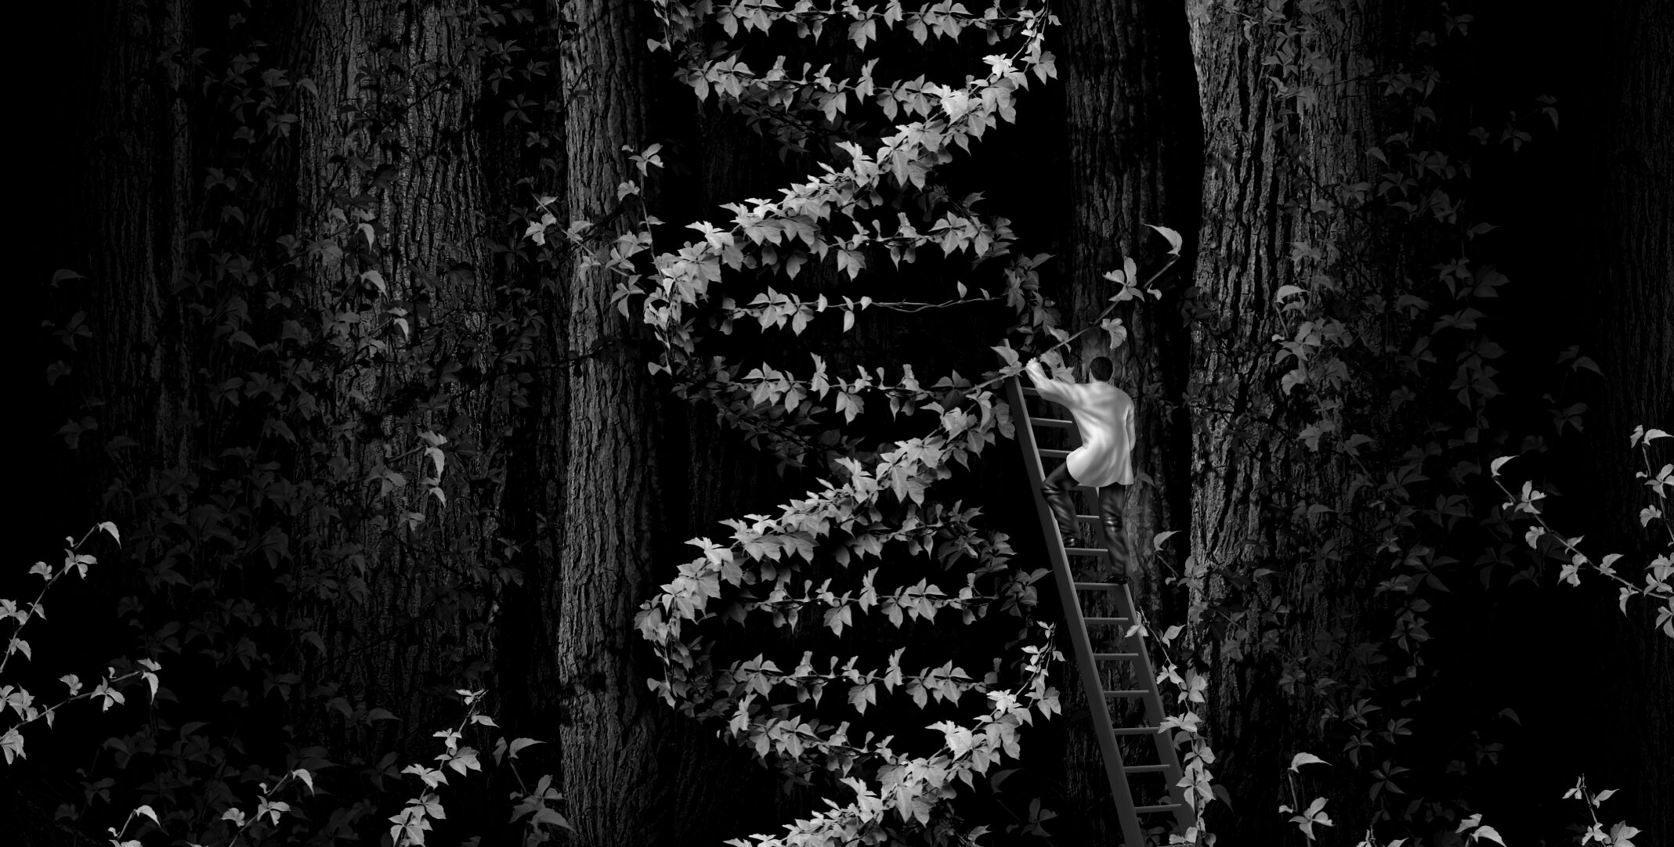
PROPOSAL
Large well-controlled clinical trials of CRISPR babies with FAAH and FAAH-OUT mutations.

Slide 10

GOAL
All prospective parents should be offered genetic screening, counselling and access to CRISPR genome-editing for happy, healthy babies.

Slide 11

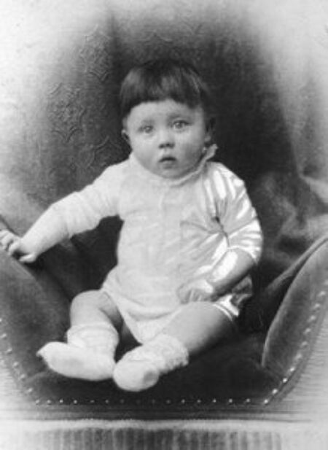
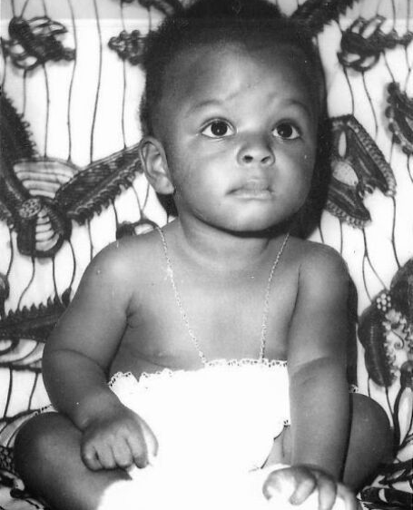
RISKS OF HUMAN GENETIC EXPERIMENTATION

Slide 12


TRANSHUMANISM
Towards a “Triple S” Civilisation of
Superhappiness, Superlongevity and Superintelligence
abolitionist.com
humanityplus.org
neuroethics.com

