Slide 1

BLUEPRINT FOR A PAN-SPECIES WELFARE STATE
Genome Reform, AI, and the Biohappiness Revolution
by David Pearce
dave@hedweb.com
hedweb.com
AI FOR ANIMALS, Berkeley 2025

Slide 2

Nature is cruel. Evolution via natural selection is an engine of immense suffering. But an intelligent species has evolved that can edit its own genetic source code. The entire biosphere will soon be programmable. Genome reform and artificial intelligence make the biology of suffering optional. This talk outlines how genome reform and AI can replace the biology of pain and suffering with a more civilized signalling system. Post-Darwinian life will be animated by information-sensitive gradients of bliss: adaptive, nuanced states of well-being that preserve functionality without experience below hedonic zero. The pleasure-pain axis will be superseded by a pleasure-superpleasure axis. Predators can be herbivorized. Population control by predation and starvation will be replaced by cross-species fertility regulation via immunocontraception and tunable synthetic gene drives. Every cubic metre of the planet will shortly be accessible to benign surveillance and micro-management by AI. Moreover, tomorrow's pan-species welfare state is just a prelude to the blissful Post-Anthropocene biosphere - a world of paradise engineering.
Life in the Hedonocene will be sublime.

Slide 3


BACKGROUND
The Abolitionist Project
Buddhism plus Biotechnology: Combining Ancient Compassion with Modern Science to End Suffering.
"May all that have life be delivered from suffering."
(Gautama Buddha, attrib.)
abolitionist.com

Slide 4


BACKGROUND (cont.)
The Reproductive Revolution
Hedonic Uplift for Humans: Towards a Hyperthymic Civilization
* Recalibrate the hedonic treadmill
* Germ-line editing can replace genetic roulette with precision engineering, elevating pain thresholds and hedonic set-points.
* Life should be based on gradients of bliss.
reproductive-revolution.com

Slide 5
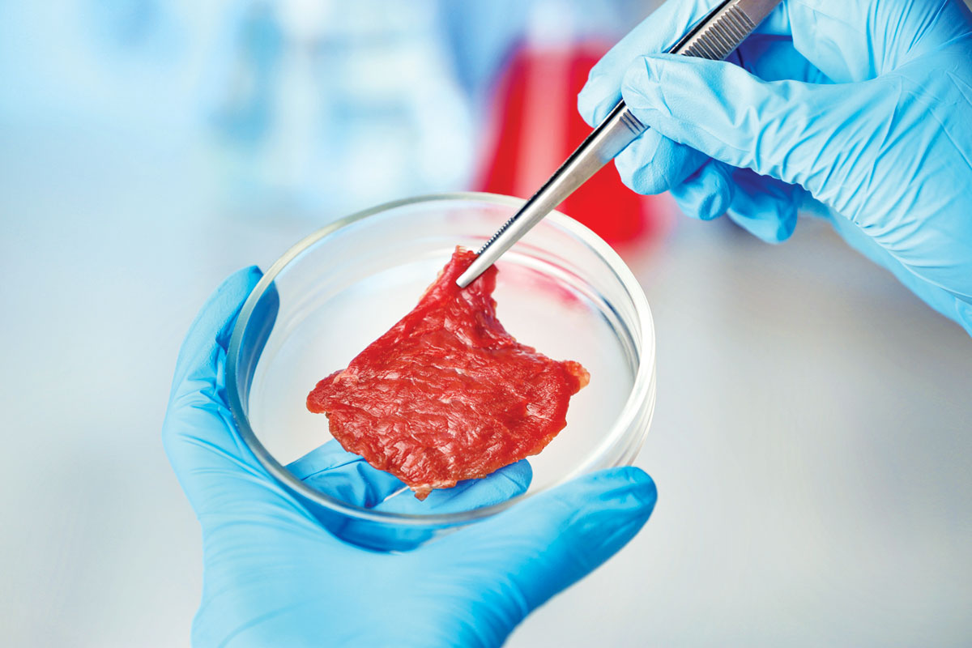
BACKGROUND (cont.)
An End to Mass Murder: The Cultured Meat Revolution
* Humans will not systematically help wild animals until we stop systematically harming captive animals in factory farms and slaughterhouses.
* Our victims are as sentient as small children.
* Cultured meat and farm-free animal products
will replace flesh from butchered animals.
* Animal agriculture must be outlawed.
* Civilization will be invitrotarian – or vegan.
Cell-cultured meat

Slide 6


WILD ANIMAL SUFFERING
Darwinian Malware: fix it or phase it out?
* Should Darwinian Life be Reprogrammed or Retired?
* What is the difference?
“Hard” anti-natalism, efilism, Benatarism (etc) won't work because of selection pressure:
https://www.antinatalism.com/hard/antinatalism-selectionpressure.pdf

Slide 7
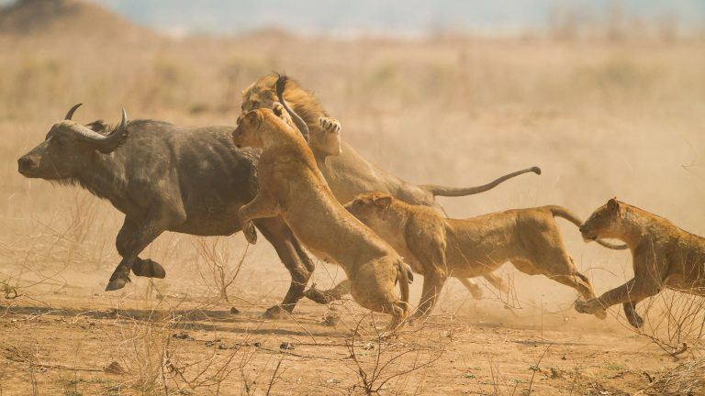
POPULATION ETHICS
Should ecologically sustainable population sizes of free-living animals be controlled by
(1) Starvation and predation?
OR
(2) Fertility regulation?
Every year, hundreds of billions of wild animals die from predation and starvation. AI-driven fertility regulation can end this cycle of horror.

Slide 8

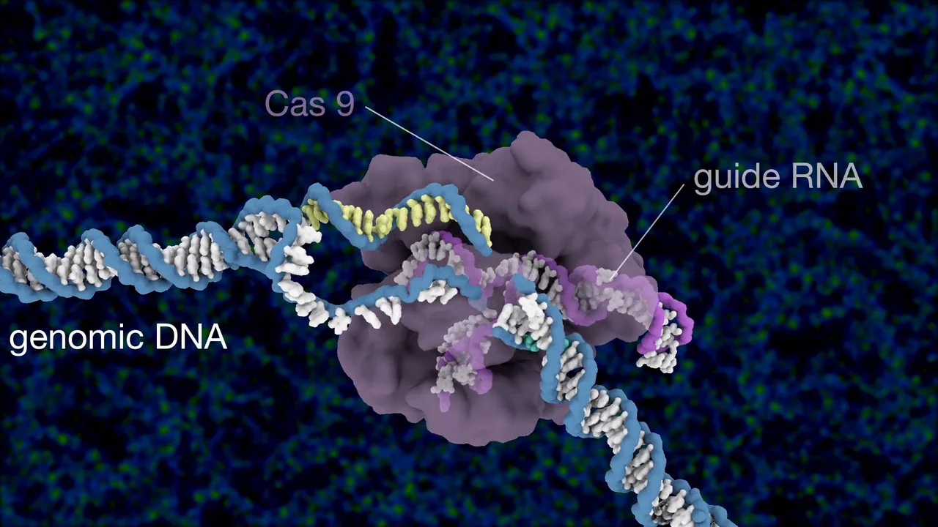
FERTILITY REGULATION
(1) Immunocontraception, e.g.
https://www.abolitionist.com/reprogramming/elephantcare.html
OR
(2) CRISPR-based synthetic gene drives
Population sizes and hedonic ranges of hundreds of thousands of species can be remotely controlled by AI via tunable CRISPR-based gene drives.
gene-drives.com

Slide 9
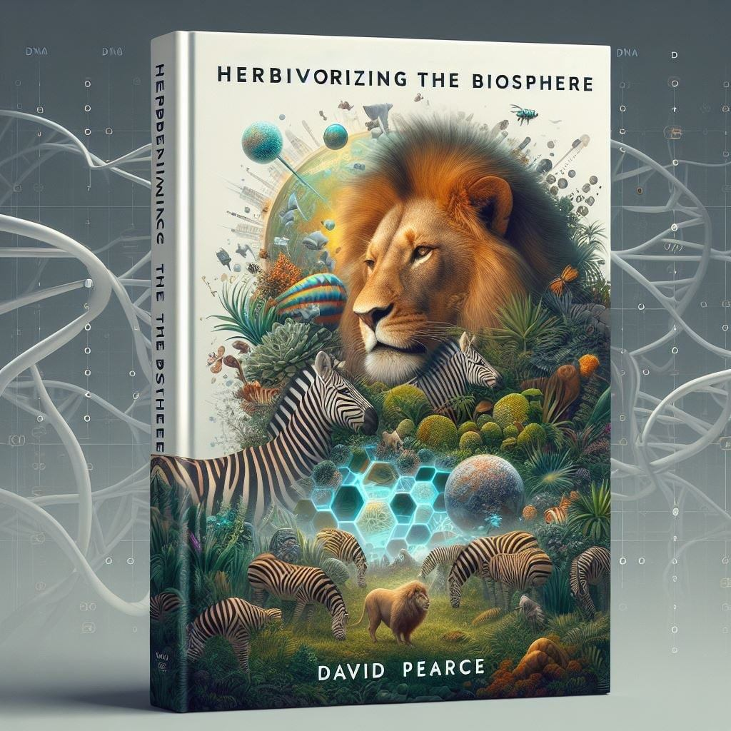

THE PROBLEM OF PREDATION
Herbivorizing Predators
Transition predators to plant-based diets via genome tweaking.
Interim solution: cultured meat and segregation
Long-term solution: genetic tweaking and herbivorization
reprogramming-predators.com

Slide 10
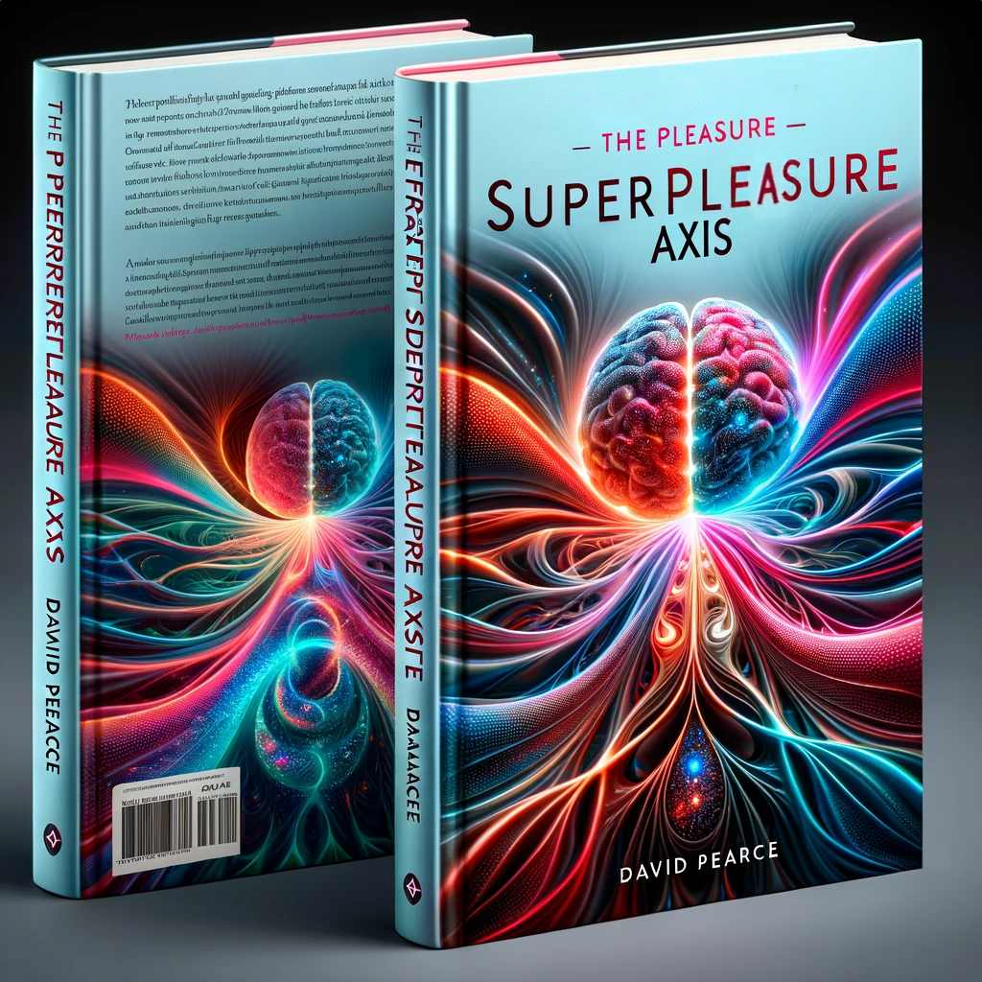

HEDONIC UPLIFT
The Pleasure-Superpleasure Axis
Why gradients of bliss?
1) a civilized motivational architecture and signalling system beyond the pleasure-pain axis.
2) allows for optional preference conservation, ensuring religious traditionalists and bioconservatives can maintain their values and relationships while still benefiting from hedonic uplift.
gradients.com

Slide 11
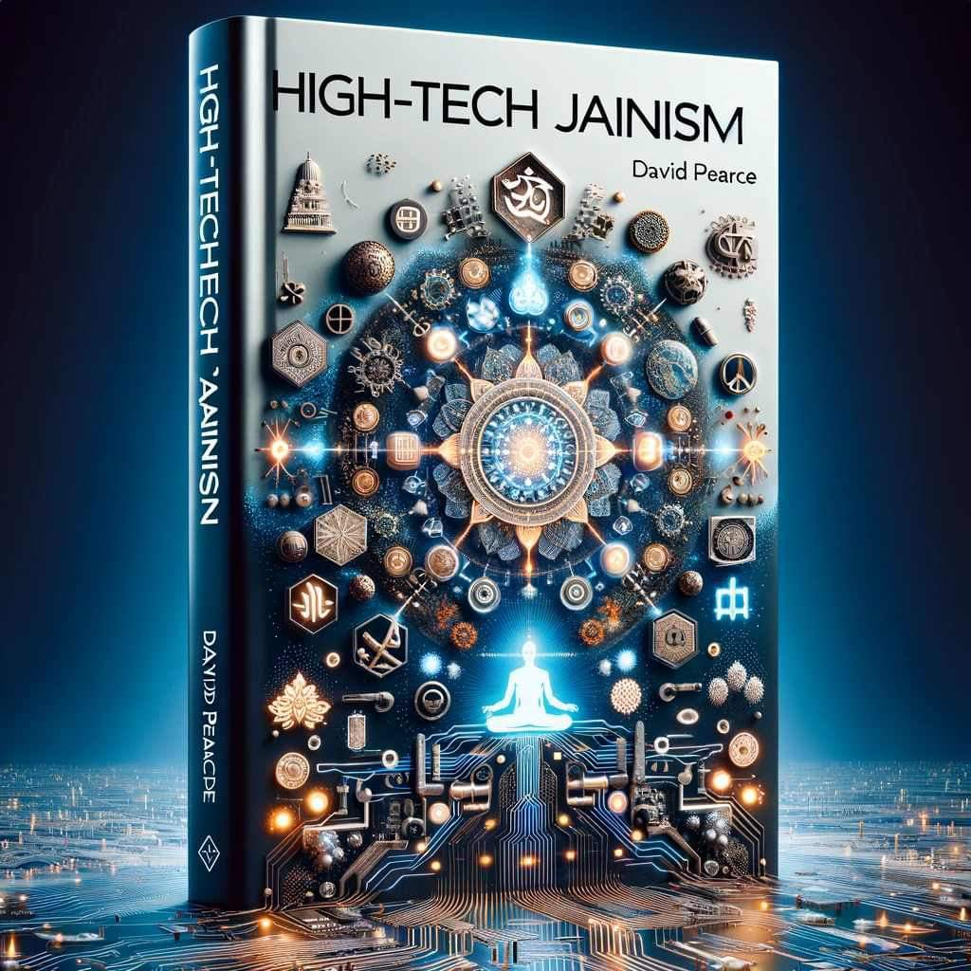

COMPASSIONATE STEWARDSHIP OF THE LIVING WORLD
"High-tech Jainism”
Jainism’s no-harm principle and genome reform, amplified by AI’s omnipresent surveillance, enables proactive care.
Every cubic metre of the biosphere will shortly be accessible to surveillance via AI-powered drones, satellites, remote sensors, and ubiquitous superintelligent nanobots.
https://www.hedweb.com/transhumanism/neojainism.html

Slide 12

SCALABILITY AND COORDINATION
* Wild animal suffering’s scale - billions of beings in diverse habitats - demands automation.
* AI can coordinate a planetary network: everything from gene-editing labs to drone fleets.
* Swarm intelligence can manage micro-robots and sensors, adapting to local conditions (jungle, tundra, ocean).
* Data feeds back for continuous refinement.

Slide 13
PRECISION WELFARE INTERVENTIONS
Hedonic Uplift: AI can ensure sentient beings have benign alleles of the SCN9A (“the volume knob for pain”), FAAH and FAAH-OUT (etc) genes.
Personalized Care: AI can design and deliver tailored interventions for individual nonhuman animals, optimizing hedonic tone, nutrition, healthcare, and environmental conditions.
Predictive Analytics: AI can predict and prevent suffering by identifying potential threats (e.g. disease outbreaks, habitat degradation) before they escalate.
Language Translation: AI can develop systems to translate, interpret and enrich communication between humans and nonhuman animals, fostering understanding and empathy.
Conflict Resolution: AI can mediate conflicts between nonhuman animals, and between humans and nonhuman animals, ensuring fair and compassionate outcomes.
Resilient Ecosystems: AI can preserve, restore and optimize habitats, promoting stable ecosystems while minimizing, preventing and eventually abolishing pain and suffering in favour of information-sensitive gradients of bliss.
Veterinary Care: AI systems can diagnose diseases in genetically reformed free-living animals with high accuracy from imaging, behaviour analysis and genetic testing, providing immediate care or preventive measures.
Species-Specific Pharmacogenomics: AI can design therapeutic drugs tailored to the revised genetic makeup of different species, reducing side-effects and increasing efficacy.
Universal Basic Well-Being (UBW) - and Beyond: AI can manage a pan-species welfare state where all sentient beings receive hedonic uplift, food, shelter and medical care.

Slide 14
RESISTANCE
Ethical and Political Opposition to Compassionate Stewardship
The idea of "herbivorizing" predators, or using AI to regulate entire ecosystems, will face immense opposition from ecologists, bioethicists, and conservatives in the general public. Most people still view Nature as something to be preserved, not radically re-engineered.
Humans shouldn’t “play God”.
BUT…

Slide 15

PLAYING GOD
Humans already massively intervene in Nature.
Humans already “play God”
So should we be
(1) callous gods?
OR
(2) benevolent gods?

Slide 16

TRANSITION STRATEGY
The Roadmap
Pilot Studies
Create blissful predation-free biospheres run by benevolent AI

Slide 17
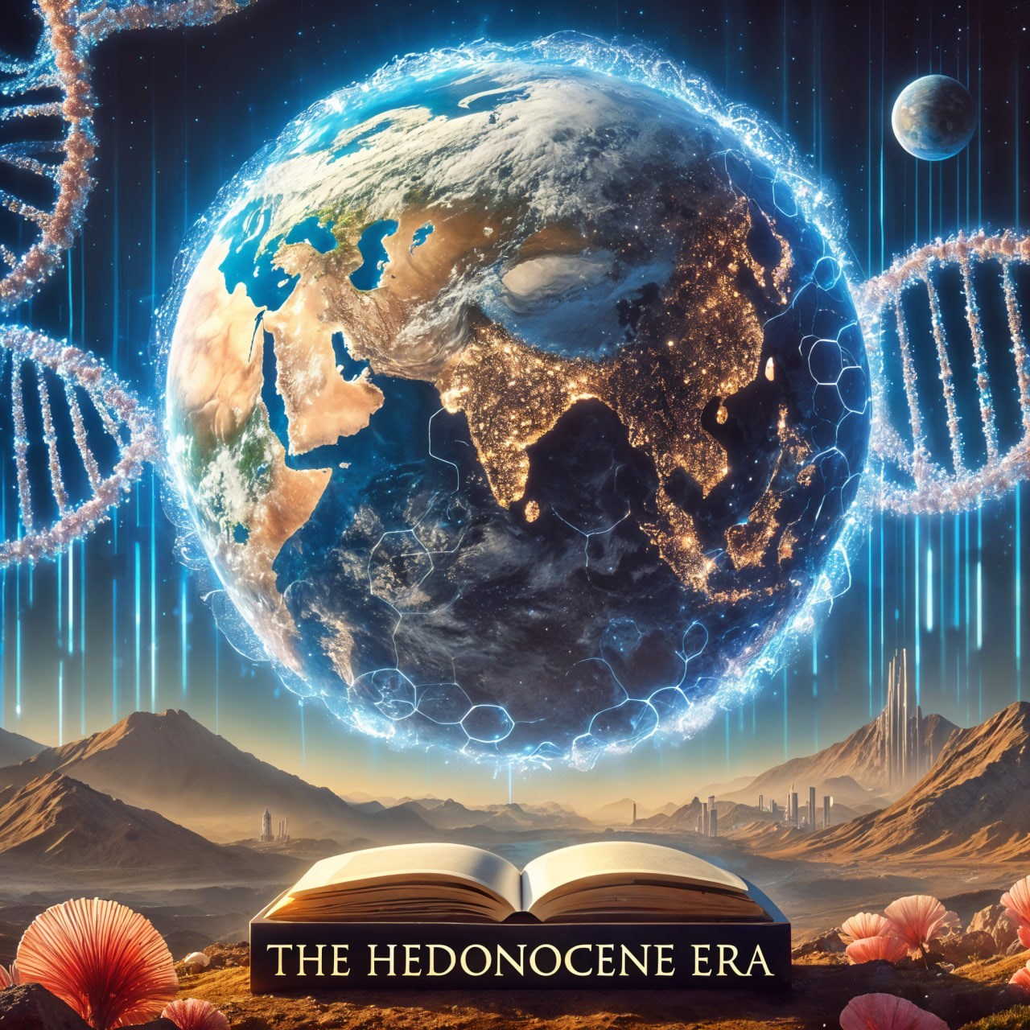
POST-DARWINIAN LIFE
From the Anthropocene to the Hedonocene
* Civilize the biosphere.
* Archaic humans and nonhuman animals thrive best when neither incarcerated nor “wild”.

Slide 18
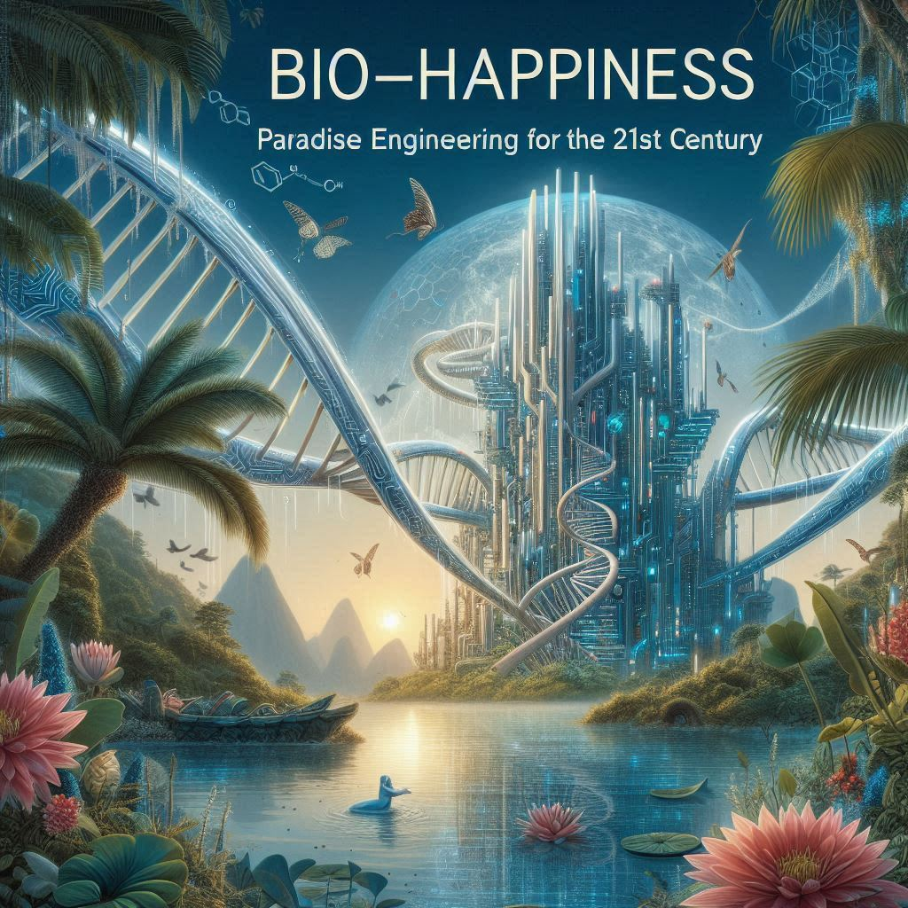

LIFE IN THE HEDONOCENE
Paradise Engineering
The End Goal: A Post-Darwinian Future of Sublime Bliss
hedweb.com

Slide 19
Thank You

