Slide 1

AN ORGANIC SINGULARITY Will Humanity's Successors Be Our Descendants? How recursively self-improving organic robots will modify their own source code and bootstrap our way to full-spectrum superintelligence David Pearce
“THE BRAIN is wider than the sky,
For, put them side by side,
The one the other will include
With ease, and you beside.”
Emily Dickinson (1830-86)
http://www.biointelligence-explosion.com/

Slide 2
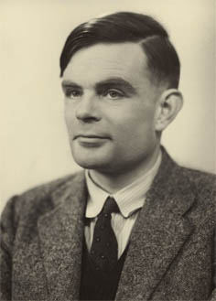
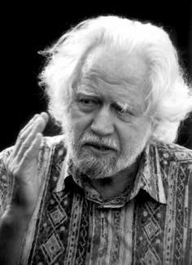
FULL-SPECTRUM SUPERINTELLIGENCE
Full-spectrum superintelligence entails a seamless mastery of the formal and subjective properties of mind: Turing plus Shulgin.
QUESTION
How can a formally defined system allude to or manipulate the diverse subjective textures of consciousness?
http://www.biointelligence-explosion.com/

Slide 3
FULL-SPECTRUM SUPERINTELLIGENCE
Why are classical digital computers zombies?
Why are organic robots sentient?
Full-spectrum superintelligence will entail solving both:
1) The Hard Problem of consciousness
and
2 ) The Binding Problem
How do networks of (ostensibly) discrete, membrane-bound quasi-classical neurons “bind” edges, colours, motion, etc into dynamic phenomenal objects and run data-driven world-simulations in real time?
What explains the unity of consciousness?
Will the solution to the binding problem explain Moravec’s paradox?
(In open-field contexts, intuitively easy, low-level, sensorimotor skills are computationally hard; intuitively hard, logico-mathematical tasks may be computationally easy.)
Refs:
Revonsuo, A. and Newman, J. (1999). Binding and Consciousness. Consciousness and Cognition 8, 123-127.
“Facing Up to the Problem of Consciousness”, David Chalmers, Journal of Consciousness Studies 2 (3), 1995, pp. 200–219.
Moravec's Paradox: http://en.wikipedia.org/wiki/Moravec's_paradox
http://www.biointelligence-explosion.com/

Slide 4
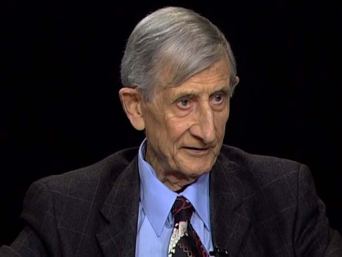
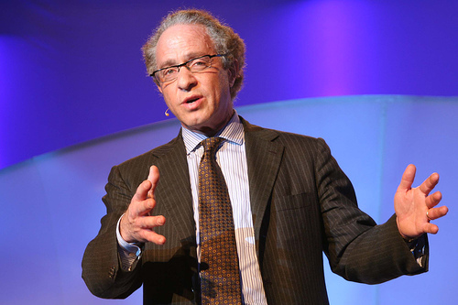
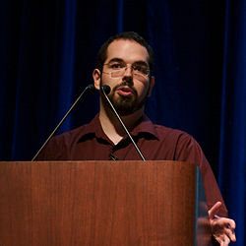
FULL-SPECTRUM SUPERINTELLIGENCE
Homo Sapiens and Nonbiological Machine Intelligence
COEVOLUTION, FUSION or REPLACEMENT?
http://www.biointelligence-explosion.com/

Slide 5
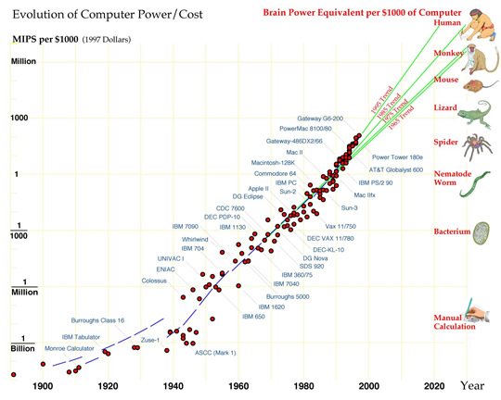
FUSION
Digital nirvana?
Kurzweil's Law of Accelerating Returns
Cybernetic brain implants
Reverse engineering the brain
“Mind uploading”
Immortality.
A Technological Singularity
http://www.kurzweilai.net/
http://singularityu.org/
http://www.biointelligence-explosion.com/

Slide 6
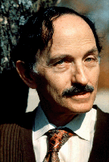
REPLACEMENT
An Intelligence Explosion
The end of the human era?
Moore's law plus recursively self-improving software-based minds will culminate in a runaway Intelligence Explosion
Barring a breakthrough in “Friendly AI”, biological humans probably face extinction.
http://singularity.org/
http://lesswrong.com
http://www.biointelligence-explosion.com/

Slide 7

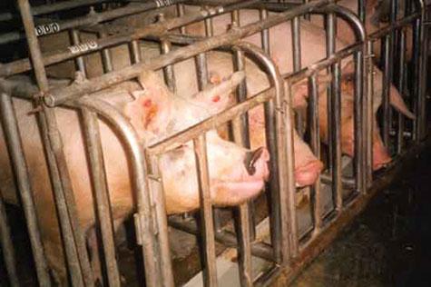
A Note On Friendly AI
Is distinctively human-friendly Artificial General Intelligence intellectually coherent? (cf. “Aryan-friendly” superintelligence)
Will Godlike Superintelligence manifest racially-specific or species-specific friendliness. Or sentience-friendliness?
But what does “sentience-friendliness” entail ?
High-tech Jainism?
Life-based on gradients of intelligent bliss?
“Uplifting” Darwinian life to posthuman smart angels?
The propagation of a utilitronium shockwave?
http://www.biointelligence-explosion.com/

Slide 8
CO-EVOLUTION.
Biohacking Your Personal Genome.
“In the future, a new generation of artists will be writing genomes as fluently as Blake and Byron wrote verses.”
(Freeman Dyson)
Germline engineering: preimplantation genetic diagnosis and designer zygotes.
and
Somatic gene enhancement:
THE OPEN-SOURCE GENETIC REVOLUTION.
recursively self-improving organic robots (“biohackers”) will modify their genetic source code.
starting with individual genes, then clusters of genes, and eventually hundreds of genes and alternative splice variants.
accelerating growth of gene authoring software and wetware editing tools, insertion vector applications, nonviral gene-editing kits, and high level user-friendly interfaces.
The smarter the nanotech and “tool AI” used for personal genome editing, the faster the pace of our cognitive self-improvement and our computer-assisted capacity for recursive self-editing.
Therefore..
http://www.biointelligence-explosion.com/

Slide 9
The PROPORTIONALITY THESIS in AI
The PROPORTIONALITY THESIS in AI: increases in intelligence lead to proportionate increases in the capacity to design intelligent systems.
QUESTION: Does the Proportionality Thesis hold for sentient, recursively self-improving organic robots who learn to modify their own genetic source code?
Can biological humans bootstrap our way to full-spectrum superintelligence?
http://consc.net/papers/singularity.pdf
http://www.biointelligence-explosion.com/

Slide 10
Can Mind-Uploading Finesse Our Ignorance?
MIND UPLOADING
Can humans scan, digitise and upload our minds into another “substrate”?
Questions:
First, given finite, real-world computational resources, can software executed on a classical serial digital computer - or a massively (classically) parallel connectionist system - faithfully emulate the external behaviour of an embodied human mind/brain?
Second, can a classical digital computer - or a massively (classically) parallel connectionist system - emulate the intrinsic phenomenology of our minds: multiple bound perceptual objects simultaneously populating a unitary experiential field instantiated by a fleetingly unitary self?
Our answers will depend on our candidate solution to the Hard Problem of consciousness and the binding problem. Are our bound phenomenal minds classical or quantum computers?
Refs:
Tegmark, M. (2000). Why the brain is probably not a quantum computer. Information. Science, 128(3-4), 155-79. [26] Woolf, N. J., Hameroff, S. R. (2001).
Why The Brain Is Probably A Quantum Computer: http://www.biointelligence-explosion.com/parable.html
http://www.biointelligence-explosion.com/

Slide 11
Four Controversial Predictions
1) Classical digital computers will never be non-trivially conscious.
2) Software-based minds are physically impossible; the Strong Physical Church-Turing thesis is false.
3) Humans will never “upload” our minds; the phenomenal binding problem defeats the possibility of our digital emulation.
4) Future experimental apparatus sensitive enough to detect quantum coherence in a macroscopic mind/brain on sub-picosecond timescales will detect, not merely random psychotic “noise”, but quantum coherent states - states isomorphic to the bound macroqualia / dynamic objects making up our egocentric virtual worlds.
http://www.biointelligence-explosion.com/

Slide 12


Shulgin
Hyper-intelligent organic minds will systematically explore the “bound” subjective properties of matter and energy: state-spaces of consciousness that do not (yet) play any information-signalling role in living organisms, and are impenetrable to investigation by digital zombies. Classical digital zombies are invincibly ignorant, and invincibly ignorant of their own ignorance.
PiHKAL: http://www.erowid.org/library/books_online/pihkal/pihkal.shtml
TiHKAL: http://www.erowid.org/library/books_online/tihkal/tihkal.shtml
http://www.biointelligence-explosion.com/

Slide 13
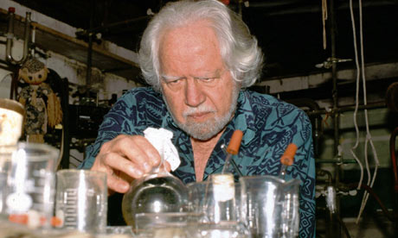
Safety
Are some forms of knowledge too dangerous to explore?
“The mind is its own place, and in itself
Can make a Heav'n of Hell, a Hell of Heaven”
(Satan, in Milton's Paradise Lost)
Genetic recalibration of the set-point of our hedonic treadmill can:
1 ) enrich the quality of our lives by delivering information-sensitive gradients of bliss: “paradise engineering”
and
2) inaugurate a Knowledge Explosion
Safe, systematic investigation of alien mind spaces and
altered states of consciousness.
“Bad trips” can be made physiologically impossible.
http://www.biointelligence-explosion.com/

Slide 14
FULL-SPECTRUM SUPERINTELLIGENCE
Responsible Stewardship of Our Hubble Volume
Superlongevity?
Superhappiness?
Superintelligence?
H+
towards the well-being of all sentience
humanityplus.org/philosophy/transhumanist-declaration/
The End
http://www.biointelligence-explosion.com/

