Slide 1
Conservation Biology versus Compassionate Biology David Pearce
ABSTRACT
Since the Cambrian explosion, pain and suffering have been inseparable
from the existence of life on Earth. However, a major evolutionary
transition is now in prospect. One species of social primate has evolved
the capacity to master biotechnology, rewrite its own genetic source code,
and abolish the molecular signature of experience below “hedonic zero”
throughout the living world. This talk explores one aspect of the
evolutionary transition ahead, namely interventions to phase out the
cruelties of Nature. The exponential growth of computer processing power
promises to let us micro-manage every cubic metre of the planet.
Responsible stewardship of tomorrow’s wildlife parks will entail
cross-species fertility regulation via immunocontraception, “reprogramming”
predators, famine relief, healthcare provision, and eventually a
pan-species analogue of the welfare state. Can science and technology
engineer the well-being of all sentience in our forward light-cone?

Slide 2

Conservation Biology versus Compassionate Biology
“We have enslaved the rest of the animal creation, and have treated
our distant cousins in fur and feathers so badly that beyond doubt, if they
were able to formulate a religion, they would depict the Devil in human
form.”
(William Ralph Inge, "The Idea of Progress" (Romanes Lecture, 27 May 1920),
reprinted in Outspoken Essays: Second Series (1922))
21st century biotechnology confers on human beings God-like powers over Nature.
What principles should govern our stewardship of the living world?
When are we ethically entitled to harm another sentient being?
When are we ethically entitled to allow another sentient being to
come to harm through neglect?

Slide 3

Conservation Biology versus Compassionate Biology
Priorities
Does Non-Human Animal Suffering Matter?
Do Non-Human Animals Suffer As Much As Humans?
Can Human Animals Help Non-Human Animals?
PROPOSAL: non-human animals with central nervous systems are functionally
and ethically akin to human infants and prelinguistic toddlers.

Slide 4

Conservation Biology versus Compassionate Biology
What is Moral Dumbfounding?
Ref: Jonathan Haidt, The Emotional Dog and Its Rational Tail: A Social
Intuitionist Approach to Moral Judgment. Psychological Review 108.4 (2001):
814-834.

Slide 5



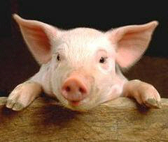
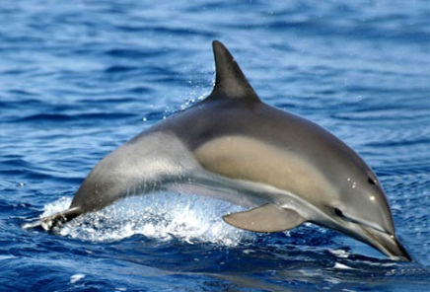
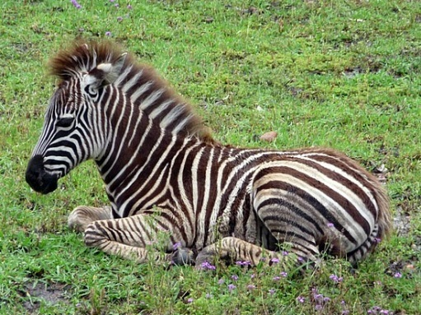
Conservation Biology versus Compassionate Biology
The Anti-Speciesist Revolution
What is Speciesism?
The ethical anti-speciesist argues beings of equal sentience deserve equal weight irrespective of species membership not members of different species deserve equal weight.
Objection: But what about POTENTIAL?
Response: We value human babies and prelinguistic toddlers for who they are, not for the mature adult they may - or may not - eventually become (cf. the love, care and medical support we accord a human toddler with a progressive disorder who will never live to celebrate her third birthday.)

Slide 6
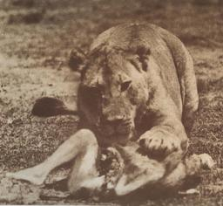
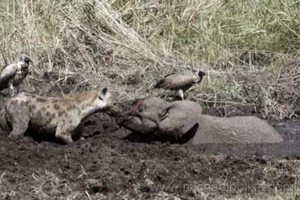
Conservation Biology versus Compassionate Biology
ETHICAL IMPLICATIONS
A Cruelty-free Vegan Lifestyle For Human and Non-Human Animals
Should We Intervene?
Is there a fundamental difference between ethical intervention to help a
human being and “sentimental” pleas to “interfere” with Nature and help a
non-human animal?
Reframing The Question.
Humans already massively intervene in Nature.
(“rewilding”, habitat destruction, captive breeding programs for big
cats, etc.)
What ethical principle(s) should govern our interventions?
What is Status Quo Bias?
What is the Naturalistic Fallacy?
Does suffering matter only when we happen to stumble across it?

Slide 7

Why?

Slide 8
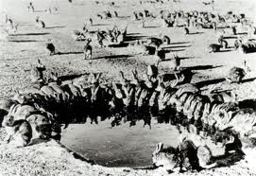
Conservation Biology versus Compassionate Biology
It Must Be So?
“The total amount of suffering per year in the natural world is beyond all
decent contemplation. During the minute that it takes me to compose this
sentence, thousands of animals are being eaten alive, others are
running for their lives, whimpering with fear, others are being slowly
devoured from within by rasping parasites, thousands of all kinds are
dying of starvation, thirst and disease. It must be so.”
Richard Dawkins
River Out of Eden (1995)
Is Dawkins right?
Will intervention do more harm than good?

Slide 9

Conservation Biology versus Compassionate Biology
Utopian Technologies
Cross-species fertility control (immunocontraception, sterilants).
Neurochips .
GPS tracking.
In vitro meat for obligate carnivores.
Genetic engineering, e.g. “reprogramming predators”.
Nanorobotics.
Global surveillance and computational micromanagement of every cubic metre of the planet (cf. the exponential growth of computer processing power: Moore's law).

Slide 10
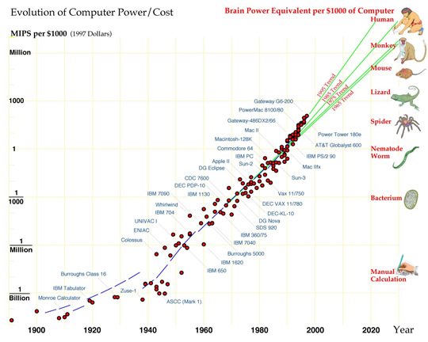
Conservation Biology versus Compassionate Biology
The Intelligence Explosion
What Is Full-Spectrum Superintelligence?
http://www.biointelligence-explosion.com

Slide 11
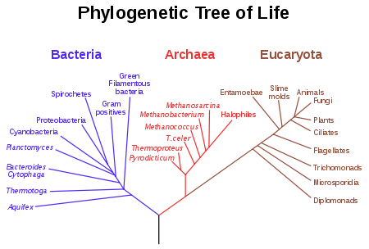
Conservation Biology versus Compassionate Biology
Ethics: what matters?
Do species matter? Do genera (families, orders, classes, phyla, etc) matter?
Do ecosystems matter?
OR
Do only individual subjects of experience matter?
QUESTION.
Does the pain-pleasure axis disclose the world’s inbuilt metric of (dis)value?
What would an impartial ‘God’s-eye-view’ of all possible first-person perspectives entail?

Slide 12
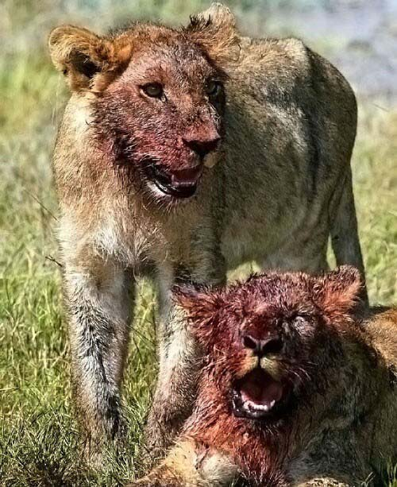
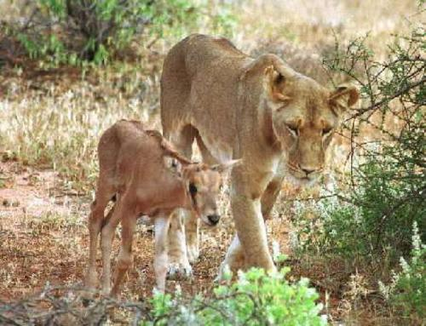
Conservation Biology versus Compassionate Biology
Conservationist Objection to Compassionate Biology:
Is a behaviourally modified lion truly a lion?
Is a behaviourally modified human still a human?
What is species essentialism?

Slide 13
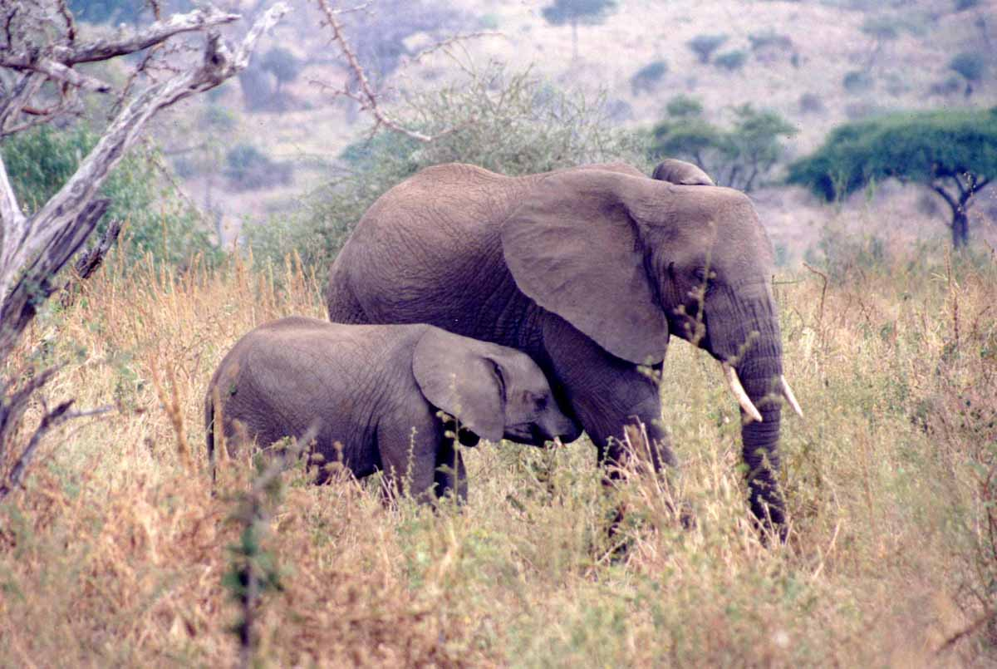
Conservation Biology versus Compassionate Biology
Compassionate Biology.
Case Study: African Elephants
(Loxodonta africana & Loxodonta cyclotis)
immunocontraception.
preimplantation genetic screening.
obstetric and neonatal support.
neurochipping and GPS tracking of c. 500,000 free-living elephant
population to monitor health and nutritional status.
veterinary care.
psychiatric and behavioural support.
orthodontics (primarily to replace terminal molars.
Otherwise healthy geriatric elephants today slowly starve to death when
their sixth and final molars wear down. Elderly elephants can no longer
adequately chew food. The malnourished elephant eventually collapses
through inanition. S/he may then be eaten alive by predators. The potential
upper bound to the lifespan of a dentally intact elephant is currently unknown.)
ANNUAL ESTIMATED COST: comprehensive program of pan-African elephant
healthcare 2-3 billion dollars (contemporary prices).

Slide 14
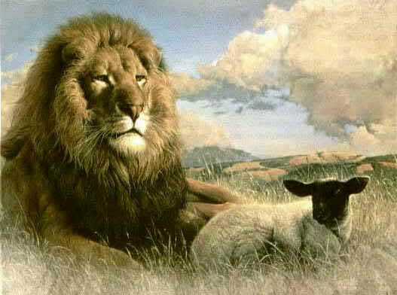
The Future of Sentience
Global Veganism
A Pan-Species Welfare State?

Slide 15
Towards the well-being of all sentience.
“The question is not, “Can they reason?” nor, “Can they talk?”
but rather, “Can they suffer?””
(Jeremy Bentham)
www.abolitionist.com
The End

