Slide 1
The Anti-Speciesist Revolution David Pearce
“Nothing more strongly arouses our disgust than cannibalism, yet we make the same impression on Buddhists and vegetarians, for we feed on babies, though not our own.”
- Robert Louis Stevenson
Each year humanity kills over 50 billion sentient beings. We confine and kill our animal cousins in ways that would earn the abuser a life sentence in prison if our victims were human. This talk will explore how Humanity+ can overcome the moral and cognitive limitations that have shaped our traditional relationship with members of other races and species. As transhumanists, can we consistently support the Transhumanist Declaration's commitment to the well-being of all sentience without adopting a cruelty-free vegan lifestyle? How close are the technologies that will allow us to abolish the biology of experience below hedonic zero? What kind of "sentience explosion" do we want to create in our forward light-cone?

Slide 2

What Is The Greatest Source of Severe and Avoidable Suffering In the World Today?

Slide 3
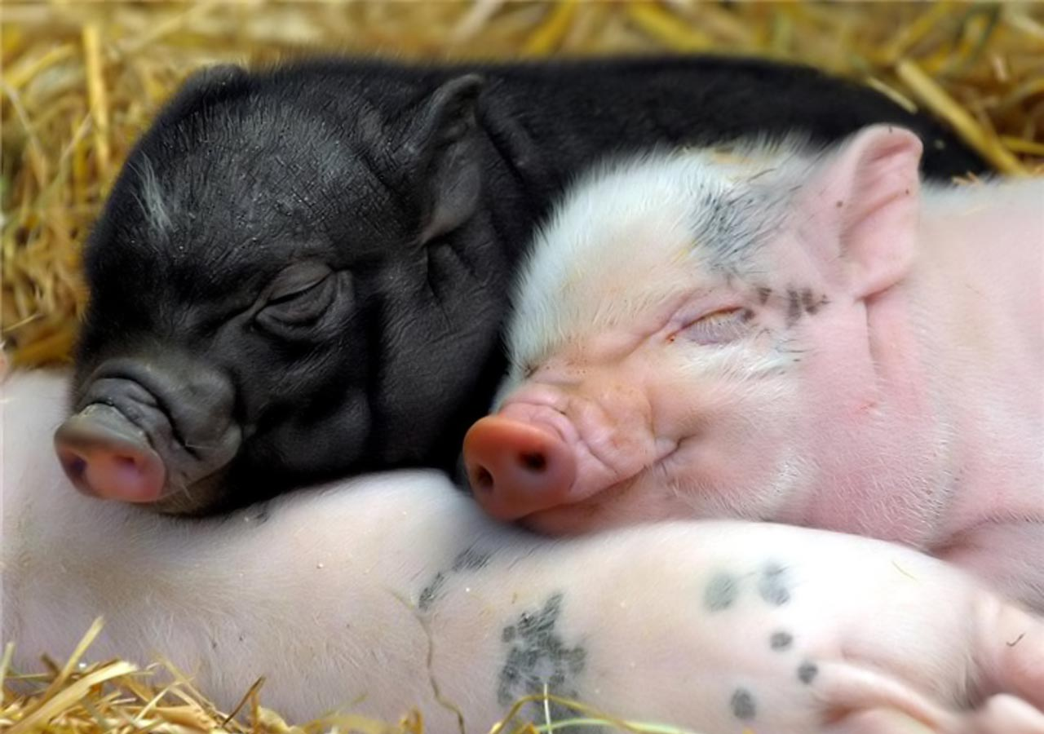
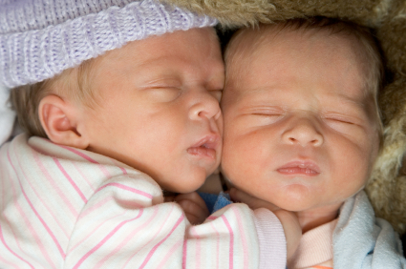
What Are The Morally Relevant Differences Between Human Toddlers and Pigs?
“Auschwitz begins whenever someone looks at a slaughterhouse and thinks: they're only animals.”
- Theodore Adorno (German Jewish philosopher)

Slide 4
What Are The Morally Relevant Differences Between Human Toddlers and Pigs?
“Then God said, “Let Us make man in Our image, according to Our likeness; and let them rule over the fish of the sea and over the birds of the sky and over the cattle and over all the earth, and over every creeping thing that creeps on the earth.”
- Genesis 1:26
“What I am doing is going along with the fact that I live in a society where meat eating is accepted as the norm, and it requires a level of social courage which I haven't yet produced to break out of that. It's a little bit like the position which many people would have held a couple of hundred years ago over slavery. Where lots of people felt morally uneasy about slavery but went along with it because the whole economy of the South depended upon slavery.”
- Richard Dawkins
(The Center for Inquiry on December 7, 2007)

Slide 5
What is Speciesism?
The term “speciesism” was coined by British psychologist Richard Ryder in 1973 to denote discrimination against non-humans based on physical differences that are given moral value.
“I use the word ‘speciesism’ to describe the widespread discrimination that is practised by man against other species… Speciesism is discrimination, and like all discrimination it overlooks or underestimates the similarities between the discriminator and those discriminated against.”
-Richard Ryder

Slide 6
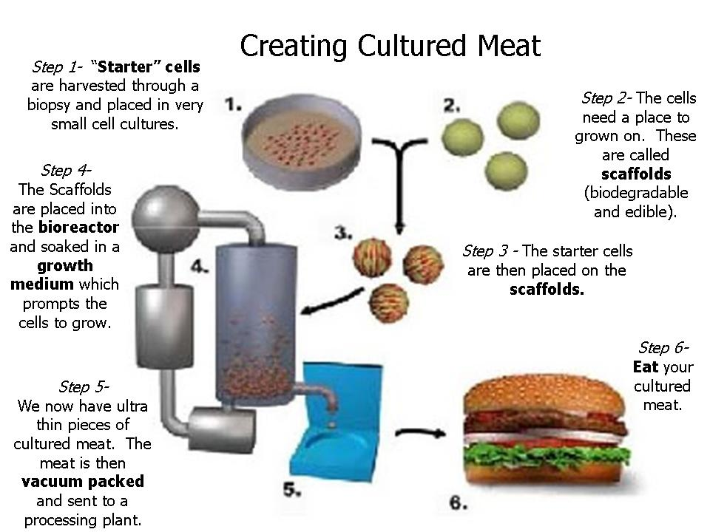
Should We Wait For In Vitro Meat?
www.new-harvest.org

Slide 7

What Is Full-Spectrum Superintelligence?
“Until he extends his circle of compassion to include all living things, man will not himself find peace.”
-Albert Schweitzer

Slide 8
“Act as if what you do makes a difference. It does.”
-William James
Veganism.com

