Slide 1
The Fate of the Meat World
David Pearce
“May all that have life be delivered from suffering”
-Gautama Buddha
(trad. c.566 BC - c.480 BC)
“We advocate the well-being of all sentience, including humans, non-human animals, and any future artificial intellects, modified life forms, or other intelligences to which technological and scientific advance may give rise.”
-The Transhumanist Declaration
(1998, last updated 2009)
www.humanityplus.org/learn/philosophy/transhumanist-declaration

Slide 2
The Challenge:
Five obstacles to the well-being of all sentient life
Physical pain - millions suffer chronic pain, but compare the fate with victims of congenital analgesia
Psychological pain – the hedonic treadmill
Meat-eating – over 50 billion factory-farmed non-human animals per year
Domestic pets (cats, etc) – obligate carnivores
Wildlife – the food chain, Nature “red in tooth and claw”

Slide 3

Congenital Analgesia
Challenge One: Physical Pain
Opposites
Hundreds of millions of people worldwide suffer from chronic pain. But congenital analgesia can lead to risky behaviour…

Slide 4
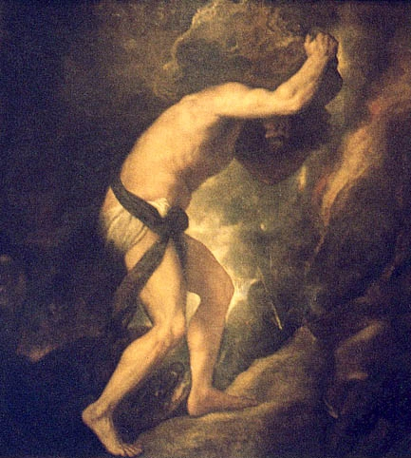
The Hedonic Treadmill
Challenge Two: Psychological Pain
Hundreds of millions of people in the world suffer chronic depression or dysthymia
Why is the heritable “hedonic set-point” of our hedonic treadmill commonly so low?
en.wikipedia.org/wiki/
Rank_theory_of_depression

Slide 5
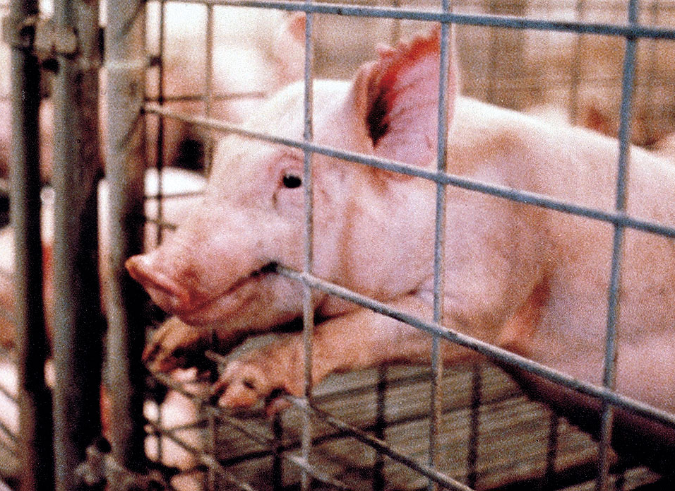
Meat Production
Challenge Three: Meat-eating
Pigs are as intelligent - and sentient - as a two year old human toddler.
Factory-farmed pigs live in crates surrounded by cold metal bars. They spend their whole lives on wet, faeces-caked concrete floors in filthy overcrowded warehouses.
Pigs may first see direct sunlight when they are crammed onto a truck bound for the slaughterhouse.

Slide 6
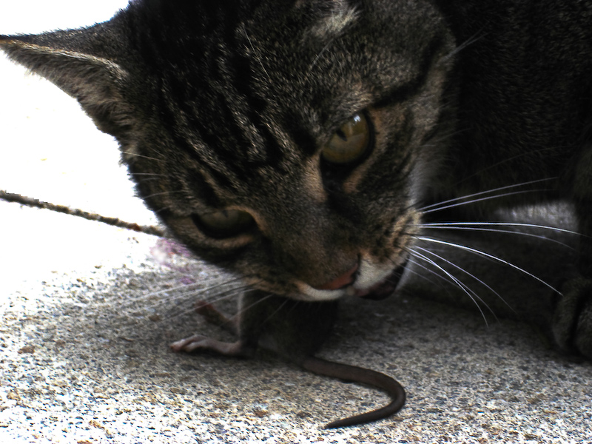
Obligate Carnivores
Challenge Four: Pets
Cats look cute.
But what does it feel like…
to be eaten alive?

Slide 7
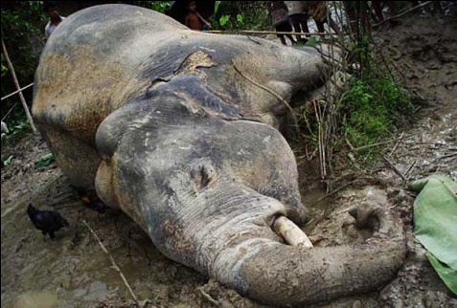
Challenge Five: Wildlife
“The total amount of suffering per year in the natural world is beyond all decent contemplation. During the minute that it takes me to compose this sentence, thousands of animals are being eaten alive, many others are running for their lives, whimpering with fear, others are slowly being devoured from within by rasping parasites, thousands of all kinds are dying of starvation, thirst, and disease. It must be so. If there ever is a time of plenty, this very fact will automatically lead to an increase in the population until the natural state of starvation and misery is restored.”
- Richard Dawkins, “God's Utility Function,”
Scientific American (November, 1995), p. 85

Slide 8
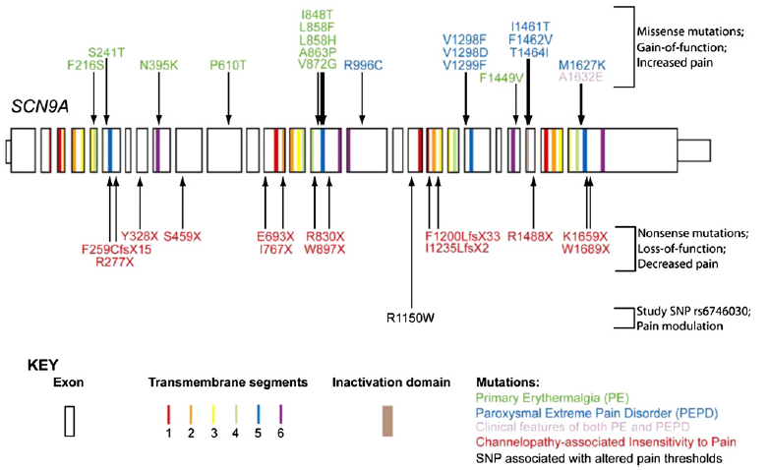
Challenge One: Physical Pain
Case Study - SCN9A Gene
A single gene plays the dominant role in our level of pain-sensitivity
Variant alleles of the gene SCN9A code for the a-subunit of the voltage-gated sodium channel Nav1.7 in nociceptive neurons
Activating mutations in SCN9A lead to rare conditions such as “man on fire” syndrome - relentless, searing pain
Inactivating mutations cause a complete absence of pain
Other alleles cause unusually high, or unusually low, pain sensitivity
Reimann et al, Pain perception is altered by a nucleotide polymorphism in SCN9A, Proc Natl Acad Sci. USA. 2010 Mar 16; 107(11):5148-53.

Slide 9
Challenge One: Physical Pain
The Reproductive Revolution
Imminent reproductive revolution of “designer babies”
Pre-implantation diagnosis will shortly become routine
Question:
Which allele of SCN9A - i.e. what level of pain sensitivity - would you choose for your future children?
Prediction:
Intense selection pressure against the nastier variants of SCN9A gene

Slide 10
Challenge One: Physical Pain
Long-term Prospects
Is abolition of phenomenal pain feasible? Or merely a reduction in pain sensitivity?
Options For A World With Nociception But No Phenomenal Pain:
Information-bearing gradients of pleasure? (functional analogues of pain - information-bearing dips of extreme bodily well-being without the nasty raw feels. cf. pain asymbolia)
Smart prostheses with a manual override (cf. silicon etc robots)
[Unsolved Mystery: Why do organic robots like us sometimes suffer, whereas our silicon (etc) robots don’t undergo phenomenal pain in response to noxious stimuli? cf. The “Hard Problem” of Consciousness; the “explanatory gap”; “zombies”; etc]

Slide 11
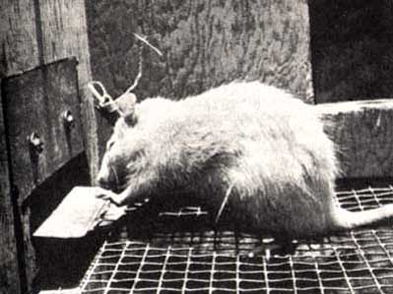
Challenge Two: Psychological Pain
The Hedonic Treadmill - Abolition versus recalibration
Wireheading? Intracranial self-stimulation of the reward centres of the brain (www.wireheading.com)
Delivers uniform motivated bliss; no physiological tolerance
BUT:
  not evolutionarily stable - selection pressure against wireheads. Wireheads wouldn’t want to raise baby wireheads
  not sociologically plausible
  a recipe for stasis
Complication: pure bliss (activation of the mu opioid receptors) and motivation / anticipated reward (activation of mesolimbic dopamine receptors) are intimately linked in the brain; but dissociable
M.L. Kringelbach & K.C. Berridge (Eds.), Pleasures of the Brain. Oxford: Oxford University Press, 2010.
Induction of pure bliss - permanent stimulation of upregulated mu opioid receptors - without dopamine-driven desire = Buddhist nirvana. But is nirvana evolutionarily stable?!

Slide 12

Challenge Two: Psychological Pain
Designer Drugs
Drug-induced pleasure can be:
shallow, amoral, one-dimensional and hedonistic
-OR-
deep, empathetic, multi-dimensional and life-enriching
Pros: reversible and fine-grained control of mood, emotion, motivation, empathy,
aesthetic sense, introspection, spirituality.
Downside: Do we really want to medicate our children from birth?
So...
Could post-genomic reproductive medicine deliver genetically preprogrammed:
invincible physical superhealth?
-AND-
invincible mental superhealth?
Current recreational drugs… | activate the brain’s negative feedback mechanisms
Current clinical drugs… | mediocre; designed to minimise “abuse potential”
Future wonderdrugs… | “Super Soma”?

Slide 13
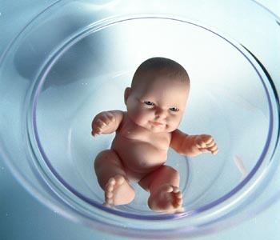
Challenge Two: Psychological Pain
The Reproductive Revolution
Question:
Prospective Parents:
What genetic setting of your future child’s “hedonic set-point” would you choose?
Would you choose any predisposition to anxiety disorders or depression?
Prediction:
Intense selection pressure in favour of happier children as transition to “designer babies” gathers pace
www.reproductive-revolution.com

Slide 14
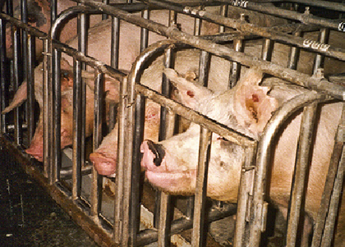
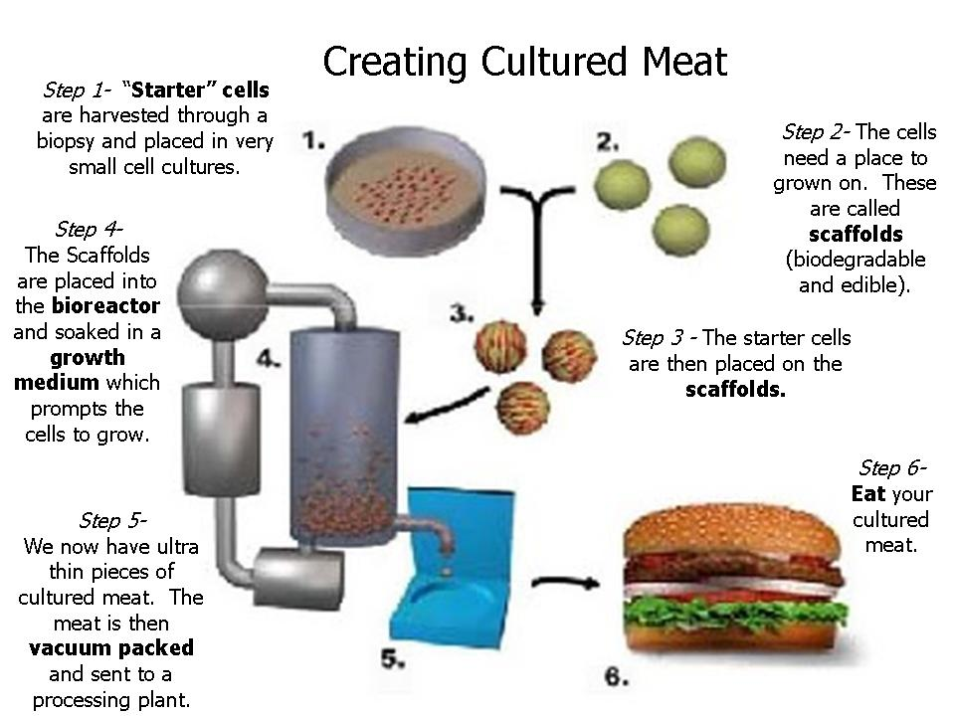
Challenge Three: Meat Eating
Overcoming Anthropocentric Bias
Should all transhumanists adopt a cruelty-free vegan lifestyle?
Factory-farmed
meat
Mass-produced
in vitro meat
vs
Can moral argument alone trump self-serving bias?
Maybe not.
But could the mass-production of inexpensive, delicious cultured meat products lead to global veganism?
en.wikipedia.org/wiki/In_vitro_meat
www.new-harvest.org

Slide 15
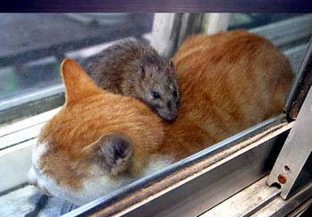
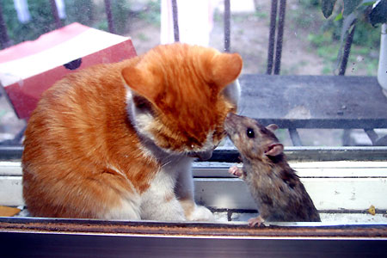
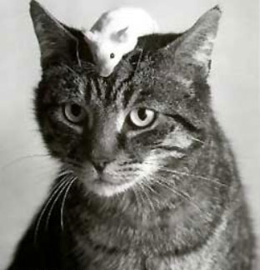
Challenge Four: Pets
Case Study
500 million domestic cats worldwide kill billions of birds and small rodents each year in gruesome ways
Stopgap remedy: e.g. mass-produced catnip-laced in vitro mincemeat?
Genetic tweaking
Long-term solution: comprehensive genomic rewrites

Slide 16


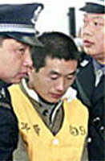
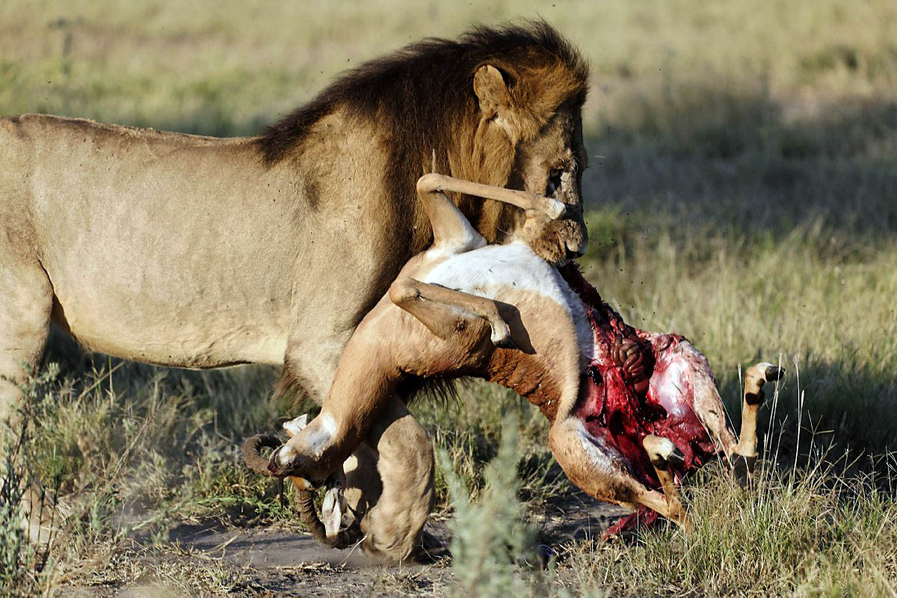
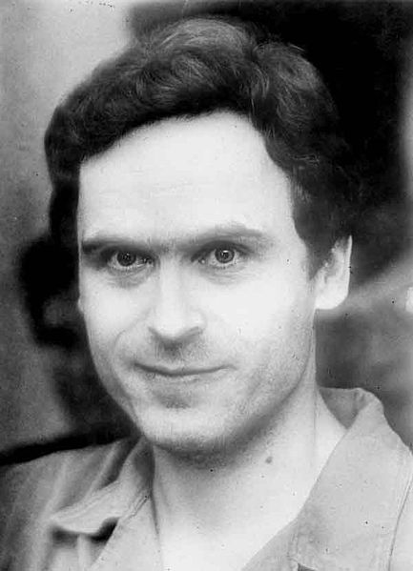


Challenge Five: Wildlife
Serial Killers Compared
Spot the difference
These predators all prey on the weak, the old, the innocent, the vulnerable...
Should we revise our double
standards?

Slide 17
Challenge Five: Wildlife
Lion and Lamb - Do we want to conserve wild animals?
If we do, what kinds of non-human animals do we want in our wildlife parks?
Is it ethical to perpetuate “predators” and “prey” - a living world full of disembowelment, suffocation, being eaten alive, starvation, dying of thirst?
Alternatives to Darwinian Life
Ecosystem redesign
Immunocontraception for population control
Reprogramming predators
Remote-controlled neuroimplants for behavioural modification
Genomic rewrites
GPS tracking and surveillance of terrestrial vertebrates
Nanobots to manage the oceans and aquatic ecosystems
“Homo sapiens, the first truly free species, is about to decommission natural selection, the force that made us.... Soon we must look deep within ourselves and decide what we wish to become.”
-Edward O. Wilson
Consilience, The Unity of Knowledge (1998)

Slide 18
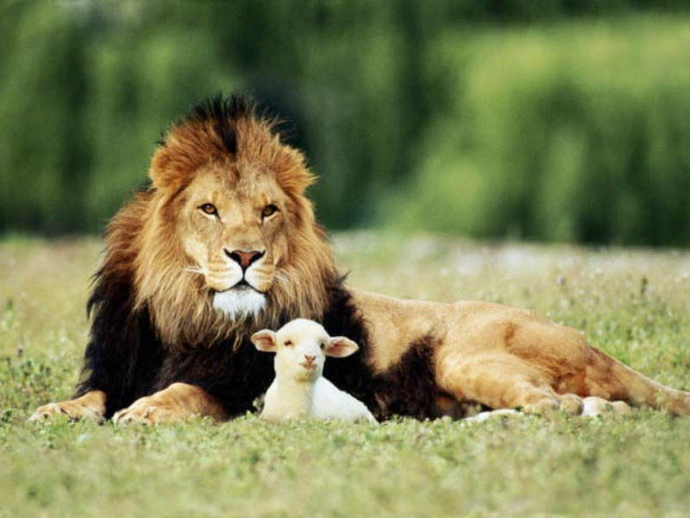
Ultimately…
A pan-species welfare state?
www.abolitionist.com/reprogramming

Slide 19
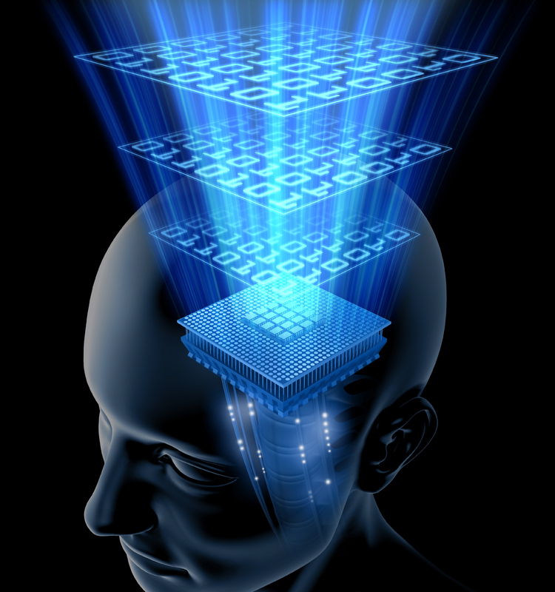
The Fate of the Meat World
Mind uploading/whole brain emulation
Is it feasible to scan and digitise
biological mind/brains and copy
their state into a supercomputer system? (en.wikipedia.org/wiki/Mind_uploading)
Maybe.
BUT: consider the meat-world selection pressure against “destructive uploading” (Will sceptics hand out Darwin Awards?)
So… Primordial life in the Basement goes on.
Therefore…

Slide 20
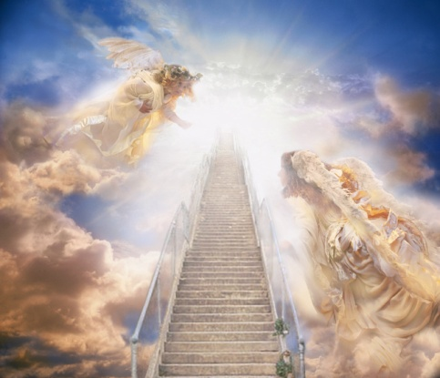
Prediction for Primordial Organic Life
“The limits of pleasures are as yet neither known nor fixed, and we have
no idea what degree of bodily bliss we are capable of attaining.”
-Jean Anthelme Brillat-Savarin
[Physiologie du Goût (1826)]
(1755 - 1826)
The Future:
Genetically preprogrammed well-being of all sentience
Animation by gradients of life-long intelligent bliss
Everyday well-being orders of magnitude richer than today’s “peak experiences”

Slide 21
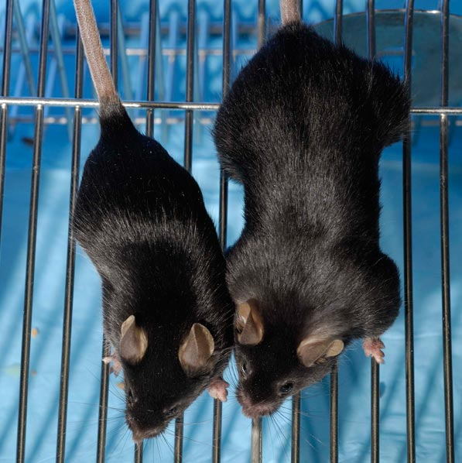
“Mighty Mouse”
Mighty muscles: normal mouse (left) and mouse that lacks myostatin and overproduces another protein, resulting in four times as much muscle.
Credit: Se-Jin Lee, Johns Hopkins University School of Medicine
SOURCE: Technology Review; October 18, 2007
Conjecture: Analogous insertion of multiple extra copies of the mu opioid receptor and regulatory promoters into the twin “hedonic hotspots” of the brain can deliver superhuman capacity for pleasure in the richest sense
Dopaminergic enhancements can deliver superhuman motivation
Can oxytocin enrichment deliver superhuman empathy?
Long Term: “re-encephalisation of emotion”?
www.superhappiness.com

Slide 22
“Whatever was the beginning of this world, the end will be glorious and paradisiacal, beyond what our imagination can conceive.”
-Joseph Priestley
(1733 – 1804)
Action: Join
Humanityplus.org
Philosophy:
Abolitionist.com
The End

